Slide 1
The impacts of Demographic change: Japan’s experience and implications for the US
Masaaki Shirakawa
Aoyama-Gakuin University
March ７, 2016
Luncheon talk at the event hosted by Federal Reserve Bank of Atlanta and The Japan-America Society of Georgia
(“US-Japan Now--Economic Impacts of Ageing” )

Slide 2
PART 1
Why am I talking about demographics?

Slide 3
Quiz
Which advanced economy has recorded the highest growth of GDP per working-age population --people aged 15 and 64--in the past 5 years, 10 years and 15 years?

Slide 4
The answer is Japan, though it may sound counter-intuitive
GDP per working-age population
GDP
CY

Slide 5
Implications
A decade is long enough for us to neglect the impact of rapid ageing
Japanese economy is not so bad as is implied by expressions frequently used in media and policy circle--”lost decade(s)”, deflation plagued country, etc.
But a sober fact is that people who can actually work is now shrinking in both absolute number and relative terms. What is important as a society is not GDP per working-age population but GDP per capita
Fundamental challenge facing Japanese economy is demographic change:
Rapid ageing
Declining population

Slide 6
Working-age population in Japan is now decreasing by one million every year

Slide 7
Demographics：Japan and the US
Growth of working-age
population
Share of working-age
population
Share of population Aged over 65
Note: Working-age population means the aged between 15 and 64 years.
Source: United Nations.

Slide 8
Motivation of my talk today
Explaining about the importance of demographics by using Japan’ s experience as a quintessential example
This is important for the rest of the world as well:
The US is no exception, being faced with demographic challenges though less severe
Challenges are acute for emerging Asia, especially for China in decade to come.⇒SLIDE 9
Unfortunately, wrong lessons are often drawn from Japanese experiences, which I am afraid might misguide macro economic policies in other countries
A case in point is debate on deflation which is grossly exaggerated⇒SLIDE 10,11
I ,too, had to confess I was ignorant about the importance of demographics 30 years ago and quite dismissive of the argument by “alarmist”
My main message is to be prepared!

Slide 9
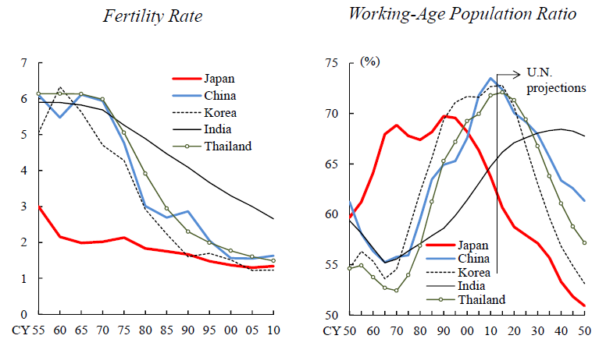
Japan is a forerunner. Other Asian countries including China are following suit

Slide 10
Yes, Japan experienced mild deflation but that is not the root cause of the problem
CPI inflation rate in Japan

Slide 11
Japan’s GDP growth rate and contribution of components: boosting potential growth is a key
 | 2012 4Q/ 2009 4Q | 2015 4Q/ 2012 4Q
GDP | 3.9 | 1.9
Consumption | 2.4 | -1.0
Residential investment | 0.4 | -0.1
Business investment | 1.2 | 0.8
Private inventory | 1.0 | 0.3
Government expenditure | 0.4 | 1.0
Net export | -1.4 | 0.7
(Export) | 0.9 | (2.6)
(Import) | (-2.2) | (-1.9)

Slide 12
PART 2
How demographics--rapid ageing and lower fertility rate-- affects the Japanese economy?

Slide 13
Demographics affects the society and the economy in various manners
Today, I will focus mainly on the first.
Growth and Inflation
Real estate prices and financial system
Differing impact on regional economy
Balance of payments
Social security and government finance

Slide 14
Japan’s long-run demographic projection is very dire
Note: Working-age population means the aged between 15 and 64 years.
Sources: Ministry of Internal Affairs and Communications; National Institute of Population and Social Security Research.

Slide 15
The net impact of ageing on growth is likely negative, though its mechanism is complex
Negative
Shrinking domestic market (demand side) and declining labor force (supply side) ⇒SLIDE 16
The impact of ageing on political process (“Silver democracy”) ⇒SLIDE 17
Relative decline in innovators who are generally young ⇒SLIDE 18
Positive
Technological innovation induced by demographic change
Long-run factors
Fertility rate
Immigration

Slide 16
Projection of Japan’s potential growth in decades to come: demographic headwind

Slide 17
“Silver democracy”: delay in social security/ fiscal reform and inclination toward short-sighted, less growth friendly policy
Does democracy work well in shrinking economy?

Slide 18
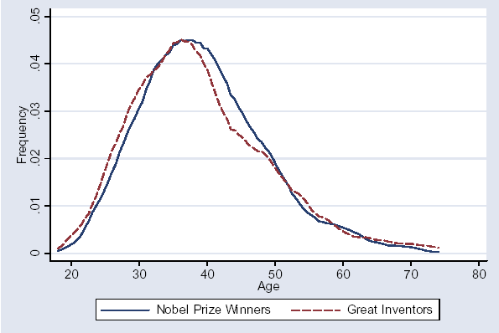
The Age Distribution of Great Innovation
Benjamin F. Jones, “Age and Great Invention” (Working Paper 11359, National Bureau of Economic Research, May 2005)

Slide 19
The process and mechanism that ageing affects growth and inflation change over time
First stage: Anticipation of ageing
An expected decline in future demand depresses current expenditure⇒SLIDE 20
Second stage: Transition toward a new steady state with fewer population
Actual decline in productive capacity due to decrease in working-age population dominates
Subsequent decline in “effective” working-age population
∵Very aged people needs growing number of caring and nursing people ⇒SLIDE 21,22
Third stage: New steady state with fewer population?

Slide 20
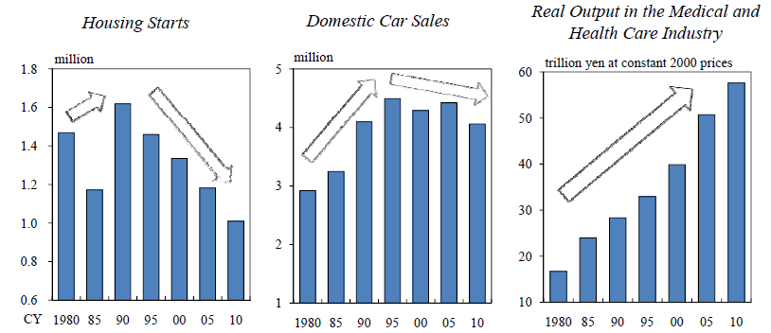
Domestic spending: change in composition and gradual contraction

Slide 21
Increased demand for medicare and nursing care service “absorbs” labor
Note: Eligibility for Medicare insurance (senior-stage) was changed from “over 70 years old” to “over 75 years old”. That change was phased in from 2002 to 2007. Nursing care insurance started from 2000.

Slide 22
“Effective” working-age population decreases more than actual working-age population
The current ratio of population aged over 65 to people engaged in medical
and welfare services is assumed constant, although it is likely to increase.

Slide 23
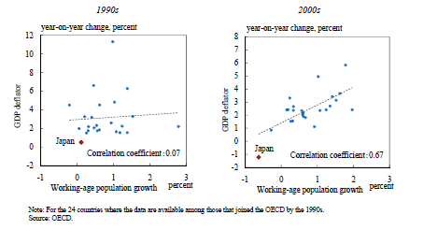
Demographics also affect time profile of inflation rate, even though it is not a dominant determinant
We come to observe positive correlation between inflation rate and growth rate of working-age population among OECD countries in the recent decade. Is this just a spurious correlation?

Slide 24
The time profile and mechanism that ageing affects inflation rate
First stage: deflationary pressure (other thing being equal)
Expectation of a decline in future demand precedes actual decline in productive capacity
Second stage: inflationary pressure (other thing being equal)
Actual decline in productive capacity due to decrease in workforce create inflationary pressure.⇒SLIDE 25
Third stage: neutral as long as fiscal sustainability is maintained. However, if this condition is not met, either high inflation or financial system instability is a consequence

Slide 25
Labor market in Japan is now tightening amid rapid decline in working-age population
 |  | Year 2005-2010 | Year 2010-2015
Change in unemployment rate (% points) |  | +0.7 | -1.7
Change in labor participation rate (% points) |  | -0.8 | 0.0
Change in working-age population (thousands) |  | -2,687 | -4,917
 | Change in employed person (thousands) | -580 | +780
 | Aged people (thousands) | +750 | +1,600
 | Female (thousands) | +230 | +980
Note: The structural unemployment rate is estimated by the Japan Institute for Labour Policy and Training.
Sources: Ministry of Internal Affairs and Communications; National Institute of Population and Social Security Research.

Slide 26
PART 3
Possible lessons for other countries

Slide 27
#1 Don’t be dismissive of the impacts of demographics: “Demographics matters a lot”
People tend to underestimate the importance of demographic change
Several observations
It is a very slow-moving picture. Population continued to increase long after fertility rate decline below replacement level because of longer longevity.
The peak of “population bonus” (late 1980s) coincided with the bubble which masked underlying problem
Once society goes beyond a critical point of ageing, it is hard to forge a politically feasible consensus because of conflicting interests between generations
People just do not want to hear gloomy story. Instead, easy explanation for Japan’s low growth—deflation-- is offered, though this is not the root cause of the problem facing Japan

Slide 28
Academic economists were generally optimistic. Issues are so intractable
Analysis called for is so disparate that economists and policymakers alike tend to inadvertently downplay the importance demographics, despite the fact that long-run is cumulative “short-run”
Yes, economists incorporate “young” and “old” in overlapping generation model. But still their focus is on “steady state”
Real challenge for society and, for that matter, policymakers and economists is the transition from one “steady state” to another

Slide 29
#2: Don’t draw wrong lessons from Japanese experience
Deflation, albeit mild, was often identified as the cause of the low growth of Japan, which led to monetary policy activism globally
But the fundamental problem is not deflation but demographics
Aggressive monetary policy is not making much difference so far⇒SLIDE 11, 30

Slide 30
Low growth in post-bubble period: Japan in 1990s and US and Europe since 2007

Slide 31
#3: We do not have one-size-fits-all solution for demographic change
The manner in which demographics affects the economy and needed policy response vary
Each society has different dynamics of politics, economy and culture.
Labor market practice
The role of family
Immigration
History as an important factor shaping society’s response
Economic and demographic conditions of neighboring countries

Slide 32
PART 4
The US economy: A view from Japan’s experience of demographics

Slide 33
In the US, direct impact of demographics on growth is projected to be less severe
Qualitatively, both Japan and the US are the same ⇒SLIDE 7
Mitigating factors:
The US has still higher fertility rate, compared with Japan
The US accepts far more immigration
Diversity due to receiving immigration is functioning like a “magnet” of attracting young entrepreneur
On top of that, the US could learn right lessons form the “aged countries” like Japan and take decisions before adverse political/social dynamics kicks in
Important caveat
Growth of working-age population of sending emigrants to the US is also declining⇒SLIDE 34

Slide 34
Annual growth of working-age population of countries sending emigrants to the US
Mexico
Top 10 countries in terms of US immigrant
Source: Ryutaro Kono (BNP Pariba)

Slide 35
Viewed from the US, demographic impact on global economy and its subtle effect on monetary policy responses are more important
Secular stagnation?
Monetary policy activism on a global scale
Its possible impact on global financial system

Slide 36
Thank you for your attention.

Slide 37
ANNEX:
Some issues that I hope economists will tackle

Slide 38
#１ In terms of population growth, is “negative” just a number below zero or special?
My observation is that negative is “special”. Fundamental reason is social, political and economic dynamics resulting from negative population growth tends to make achieving stationary population growth difficult.
Counter-argument is possible. So far, we focused mainly on advanced economies and emerging economies. But after all, world population is growing rapidly, especially in African countries. If we look at issues from truly global perspective, how does my observation change?

Slide 39
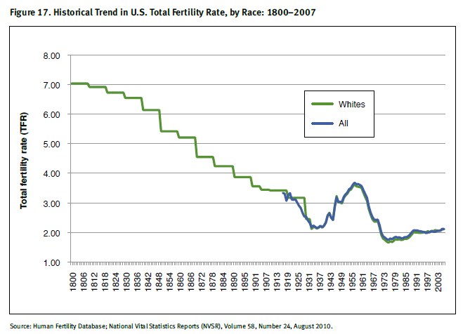
＃２ After all what determines long-run trend of fertility rate?
Report to the Social Security Advisory Board (September 2011)

