Slide 1
Teen Unemployment: What's the Real Story?
Lesson Objectives
Define key terms such as labor force, labor force participation rate, unemployment, unemployment rate, structural unemployment, frictional unemployment, and cyclical unemployment.
Calculate the labor force, labor force participation rate, and the unemployment rate for their school.
Compare those who are unemployed to those who are not working and out of the labor force.
Role play people experiencing the different types of unemployment.
5. Evaluate employment situation at their high school and communicate their findings using a press release.

Slide 2
Who is unemployed? Sort the statements into the correct categories:
An engineer working at a fast food restaurant while looking for a job in her career field.
A 17-year-old high school student with no job who is looking for a job at a supermarket.
An adult who has no job and has given up looking for a job.
A 16-year-old who was paid for yard work last week and is looking for a job in retail.
A 15 year old with no job who is looking for a job.
An adult looking for a job who was not paid for work last week.
Unemployed
Not Unemployed
An adult looking for a job who was not paid for work last week.
A 15 year old with no job who is looking for a job.
A 17-year-old high school student with no job who is looking for a job at a supermarket.
An engineer working at a fast food restaurant while looking for a job in her career field.
A 16-year-old who was paid for yard work last week and is looking for a job in retail.
An adult who has no job and has given up looking for a job.

Slide 3
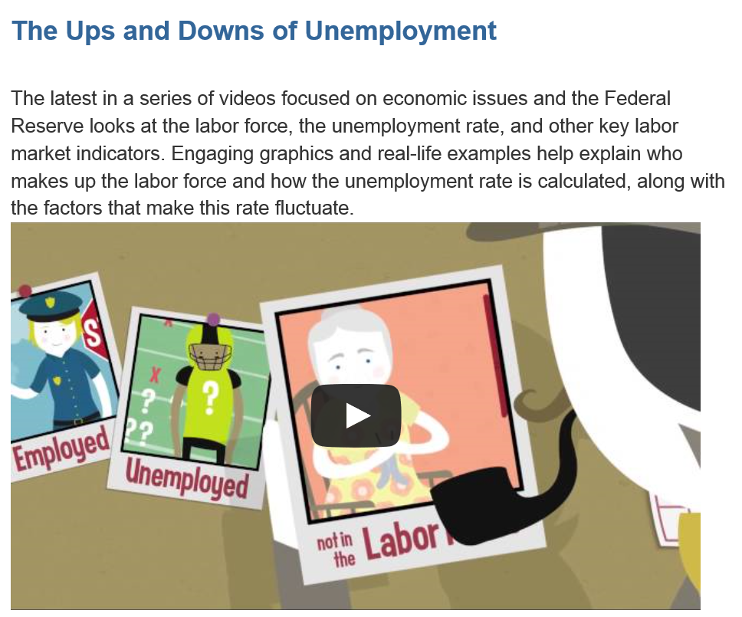
The Fed Explains...

Slide 4
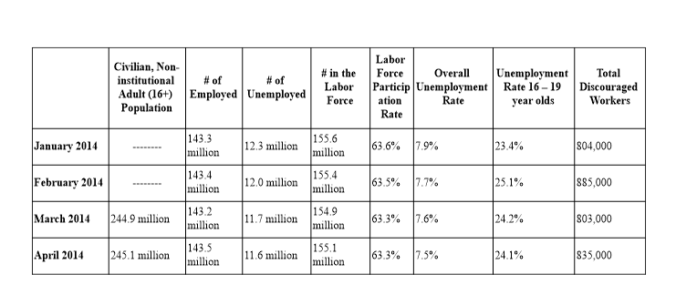
Visual 1: Recent Unemployment Numbers

Slide 5
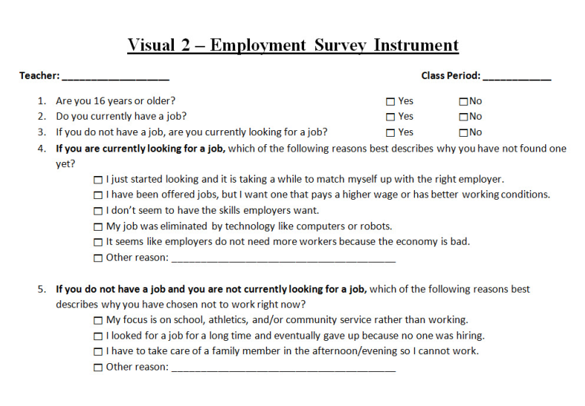

Slide 6
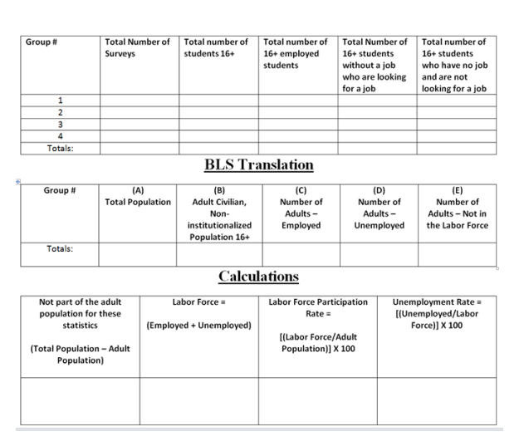
Visual 3 – Calculating Employment Numbers

Slide 7
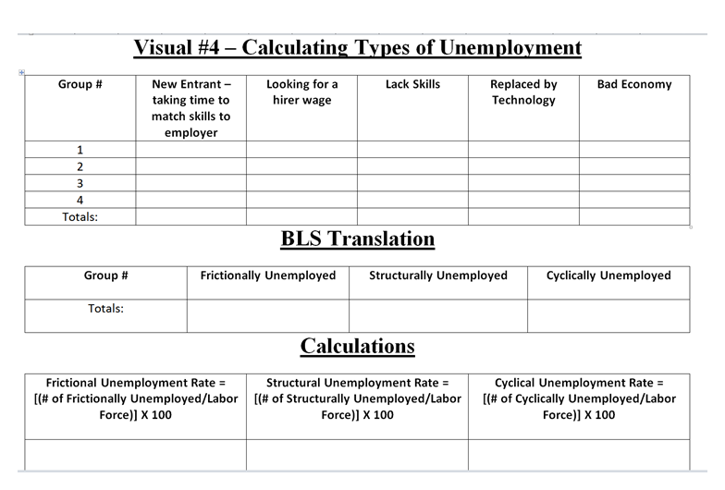

Slide 8
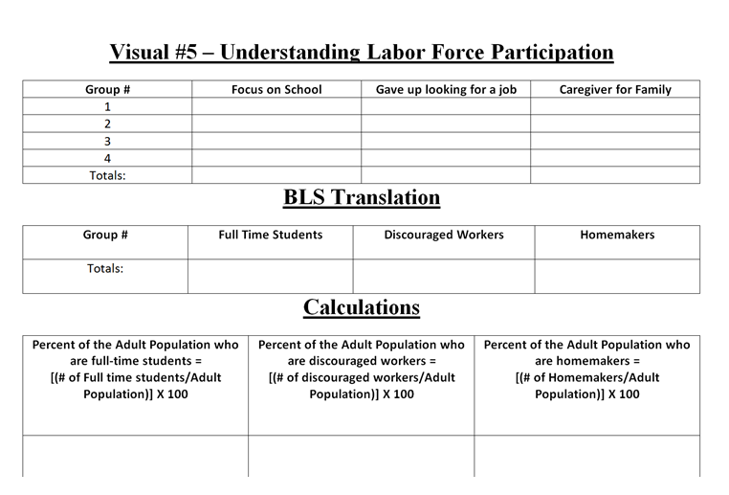

Slide 9
Writing the Press Release
1. Summarize your data.
2. Explain what you think the data means.
3. Evaluate whether the principal's concerns about unemployment are justified.
4. Recommend solutions to the teen unemployment problem and/or explain why the percentage of students working is unlikely to change.

Slide 10
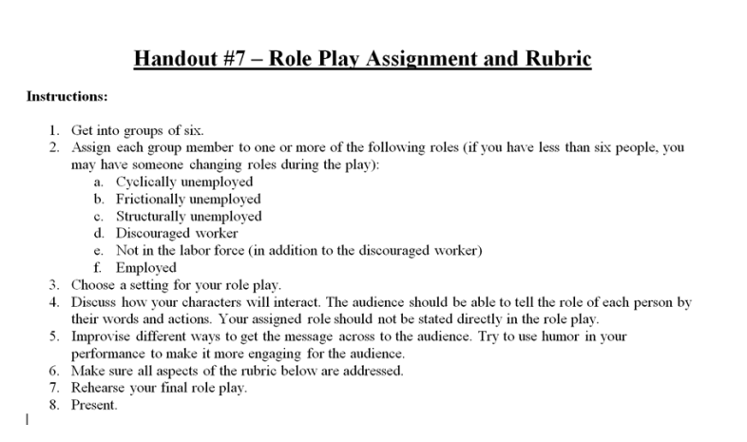
The Role Play

Slide 11
Match the type of unemployment to the examples:
Word
Description
Jordan quit his job when he had a conflict with his supervisor; he is now looking for another job.
Frictional
Ally’s job as a tour guide was eliminated when the recession reduced the number of people taking vacations; she is now seeking work.
Cyclical
Remmi lost his job putting doors on cars when the company installed robots; he is now looking for another job where he can put doors on cars.
Structural

